Slide 1
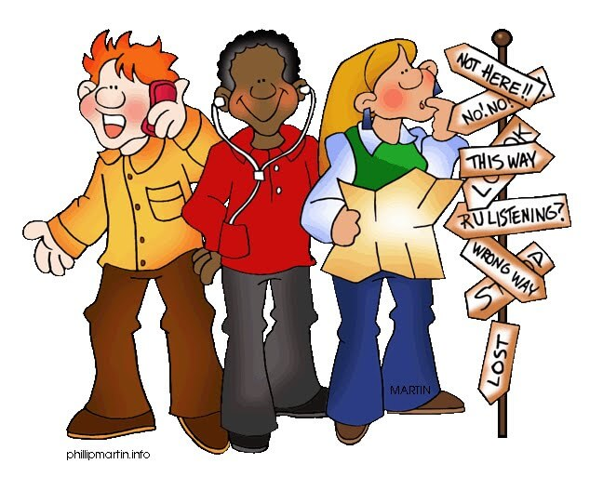

Slide 2
How to start!
Excuse me / Excuse me sir or madam.
I am new here.
I’m lost.
I am sorry to interrupt you, but…
Excuse me, could you help me, please?
I am sorry.
Sorry, I am not from around here.
Excuse me madam, I seemed to be lost.
Hello / Hello sir or madam.

Slide 3
Sometimes we or someone need to find a place. And we need to ask someone else for help. When we’re asking for directions to someone, we use some phrases. These are given below
Can you give me directions to the nearest hospital?
Are we on the right road for London?
How do you get to the bus stop?
Where is the carnival?
Where can I find the nearest car park?
How do I get to library?
Is there a pet shop near here?
Where is the nearest post office?
Do you know where the shopping center is?
Is there a sports shop around here?
Can you tell me how to get to train station from here?
How can I get to the pub?

Slide 4
What’s the best way to get to the amusement park from here?
What’s the quickest way to get to the airport from here?
What’s the easiest way to get to the nearest drugstore from here?
Could you tell me where the nearest grocery store is?
Where are you exactly?
How do you get to the supermarket from here?
I am looking for this address, am I in the right place / how can I get there?
Can you tell me the way to the Nature Hotel?
Is this the right way for the campground?
Do you have a map?
I am trying to find an exchange office. Could you tell me how to get there?
I am trying to get to the police station, Can you show me on the map?
Could you help me, please? I’m looking for the bank.
Does this bus go to the center?
Do you know the cafe?

Slide 5
a. Giving Directions to Say ‘Go Straight’
Go straight.
Go along the road.
Go down there.
Go down or walk down the street.
Go up or walk up the street.
Go straight along this road.
Go past the bus stop.
Go toward the church.
Go ahead.
Go straight ahead
Go ahead and ask someone.
Go on ahead.
Go straight on until you come to the crossroad.
Go straight on left / right.

Slide 6
Go straight at the lights / at the roundabout /at the junction.
Continue straight ahead for about a mile.
Continue past the petrol station. ( paas the station and continue)
Continue straight on past two traffic lights.
Continue straight ahead for about two kilometres.
Keep going for another station.
Keep going down this Street.
Keep going for another shop hundred metres.
Keep going straight ahead you will see it on the right.
Keep on the straight road.
Keep walking ahead.
Take this road.
Walk to the corner.
Follow this street for 300 metres.
Follow the road until you get to the bank.

Slide 7
Giving Directions to Say ‘Turn’;
Turn right.
Turn left.
Turn left past the bank. ( pass the bank and then turn left )
Turn back. ( go back)
Turn left after the bridge.
Turn right at the second
Turn right from the first alley.
Turn left on to Daniel Street.
Turn left at the end of the corridor.
Turn right / left at the traffic lights / roundabout, etc.
Turn right on after you pass the market on the right also.
Turn left after you pass the bakery.
Turn left past the phone shop.
When you see a school on your right hand side, turn left in to European Street.

Slide 8
Turn left after you pass the bakery.
Go right / left at the end of the road.
Take the first right”.
Take the first / second / third street on the left / right.
Take the first left when you enter Steven Road.
You need to take a left / a right at the next traffic lights.
Take a right / left at the junction.
Take the second exit at the T- junction and then turn right at the traffic rights.
When you get to Paris Street, take your next right.
After you pass the restaurant on your left, take a right at the next crossroad.
If you take the road on the left, you’ll come to the post office.
Take a left when you come to the main street.
Round the corner from the post office.

Slide 9
Giving Direcitons to Say ‘Cross’;
Cross the pub.
Pass the school.
You will cross some traffic lights.
Cross the taxi rank and you are there.
Go over the bridge

Slide 10
Giving locations: * Commonly used prepositions for giving locations are colored below.
It is …
on the left.
on left.
on the right.
on right side.
on left after the gas station.
opposite.
opposite the bank.
on opposite side of the Street.
across the road.
near my office.
next to Mall.
behind the hospital.
in front of the bus station.
between the our office and the supermarket.
on the right in between the pet shop and the grocery store.

Slide 11
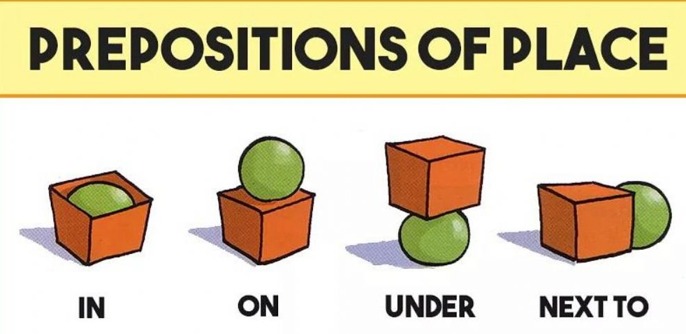
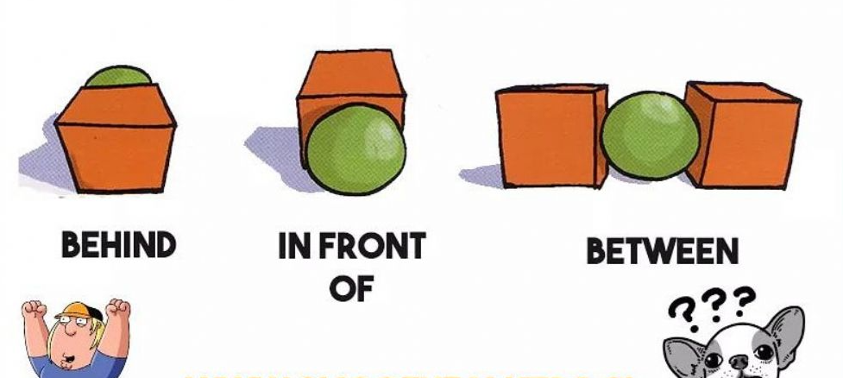

Slide 12
at the end of Paris Street.
on/at the corner of Daniel Road.
over there, near the police station.
(just) around the corner.
just around the corner on the left / right side.
left around the corner next to the market.
left around the corner from the subway.
further down the road on the left.
the biggest / smallest building on the left.
in the centre of the town.
the first turning on the right after the bank.

Slide 13
Other useful phrases for giving direction:
It is this way / that way.
You are going to wrong way.
You are going in the wrong direction.
You will pass a bakery on your left.
It will be on your left or right.
This straight road will lead you to the hospital.
You will see the entrance on the left.
You will pass a taxi rank on your left.
Follow the sign for the town centre.
You will see the car park infront of you.
You can’t miss it.
Come off the motorway / highway at the junction.
The signpost said “London 18 miles” or “America”.
Follow the signs to..
You will come to a bus station.
You will see the Black Lake.

Slide 14
Asking for repetation:
Sorry, I didn’t catch that.
Could you say that again please?
Could you repeat it again please?
What did you say the street’s name was?
Could you speak up please?
Could you speak a little louder?
Could you show me please?
Finishing Conversation:
Thanks for help. Bye .
Thank you for help. Good bye.
Thank you for spending your time with me. Have a nice day!

